Slide 1

大
院
浙
儿
DEVELOPING AN EARLY WARNING MODEL FOR SEPSIS IN TRAUMA PATIENTS

Slide 2
CONTENTS
报告内容
Background
Study Design
Results
Plans

Slide 3
Background
背景
Post-traumatic sepsis is a significant cause of in-hospital death. However, clinical characteristics and lab tests that may predict sepsis in trauma patients are not well known
创伤后脓毒症是患者死亡的重要原因。 然而，可能预测受伤患者脓毒症的临床特征和实验室指标尚不确定
Objective ：identify risk factors and early warning model that may be associated with post-traumatic sepsis
创伤后脓毒症危险因子和预测模型

Slide 4
Study Design
研究设计
ICU admissions in the database
(n = 58,967)
Excluded:
Non-trauma admissions
OR Age <= 18
Trauma patients
(ICD 9 code)
(n = 2658)
Sepsis-3:
- SOFA >= 2 AND
- Infection (ICD 9 code)
(n = 684)
Sepsis-3 criteria not met
(n = 1974)
Study Group
Control

Slide 5
Study Design cont.
Exposed variables of interest (first 24 hours after ICU admission)
(1)Physiological data：T/BP/HR/RR/ oxygen saturation/ Hemodynamic data
(2)Laboratory result：Arterial PH / arterial blood PCO2 /arterial blood PO2/ blood Ca+ /blood K+/WBC/Neutrophils/Lymphocytes/RBC/HGB /PLT/PCT/ Blood Glucose /BLA/ Cr / BUN / URINE ROUTINE/ ALT/AST/ IL/CD4,8/microbial
(3)Fluid balance：IVF/oral fluids/medications/urine/stools/other body fluids
(4)Score：GCS /SOFA/ PRISM III /ISS /Shock index
(5)Demographic information：age/sex/weight/ underlying disease/trauma site
(6)Clinical intervention：Mechanical ventilation (time)/diuretic use/vasopressor use/ PICCO use
Outcome of interest
Sepsis
In-hospital mortality
Length of hospital stay

Slide 6
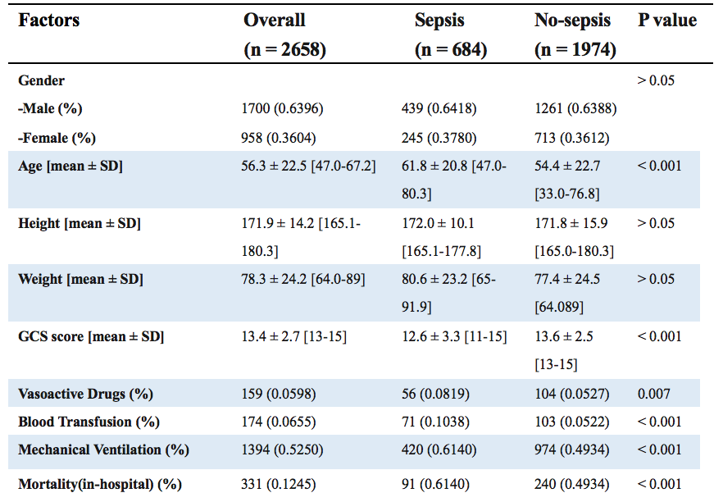
Results
研究结果
Demographics
人口特征
Rank Sum Test for continuous variables; Fisher test for categorical variables

Slide 7
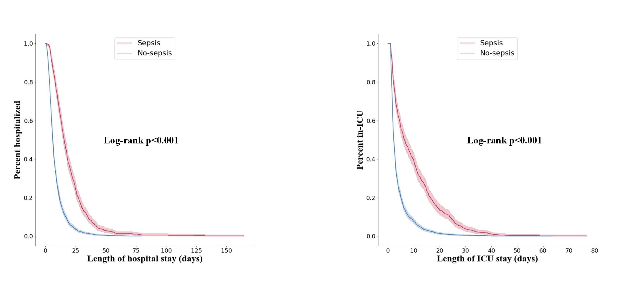
Results cont.
Length of hospital and ICU stay in septic and non-septic patients
脓毒症与非脓毒症病人住院及ICU时长比较

Slide 8
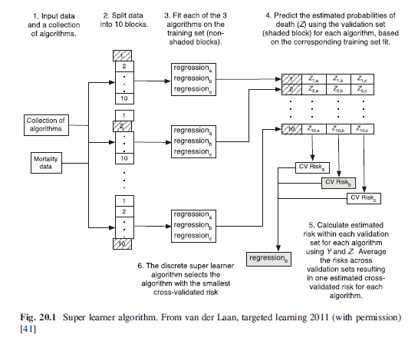
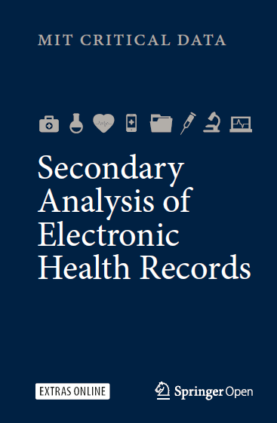
SuperLearner
task | AUC | ACC | Recall
Sepsis | 65.3 | 75.79 | -
Mortality | 81.12 | 90.23 | 70.73

Slide 9
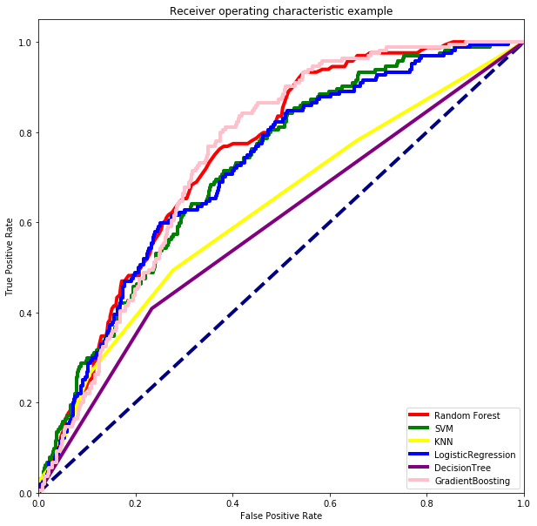
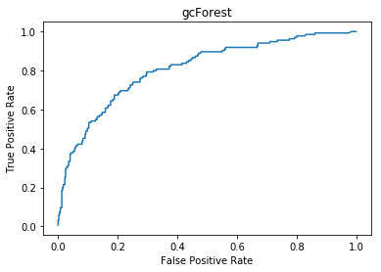
Results cont. 3
Sepsis 脓毒症
Model | auc | acc | recall
GCForest | 0.80 | 0.81 | 0.452
rf | 0.7502 | 0.7519 | 0.2012
svm | 0.675 | 0.3368 | 0.9512
knn | 0.6266 | 0.7398 | 0.2622
lr | 0.7177 | 0.7474 | 0.2866
dt | 0.5805 | 0.6707 | 0.4024
gb | 0.7405 | 0.7383 | 0.3049

Slide 10
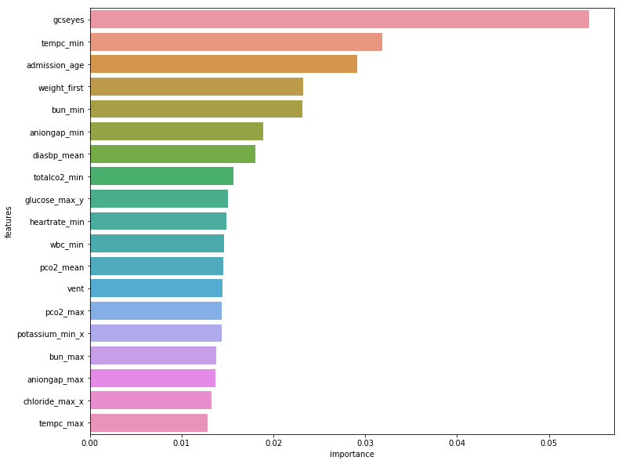
Results cont. 4
gcForest sepsis importance 预测脓毒症重要性
Risk factors 预警因子
GCS score (eyes)
Temperature
Age
BUN
Anion gap
Diastolic BP
Total CO₂
Glucose
HR
WBC
…

Slide 11
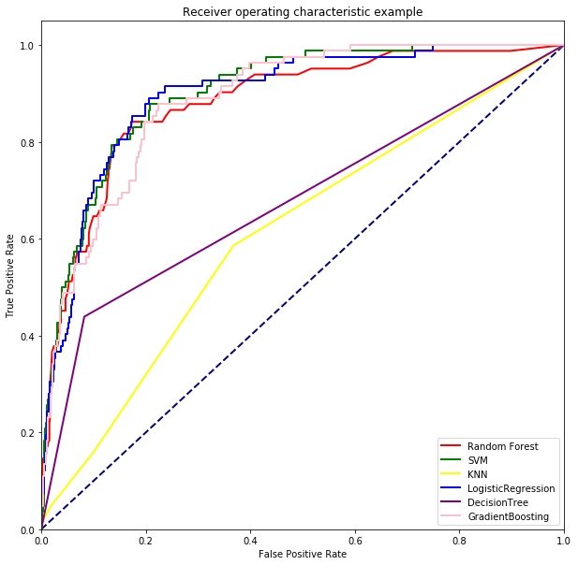
Results cont. 5
In-hospital Mortality 死亡率
model | auc | acc | recall
RF | 0.8754 | 0.8872 | 0.1463
SVM | 0.8735 | 0.6346 | 0.9512
KNN | 0.6102 | 0.8662 | 0.0488
LR | 0.8959 | 0.8887 | 0.3659
DT | 0.6966 | 0.8632 | 0.4756
GB | 0.8869 | 0.9023 | 0.3537

Slide 12
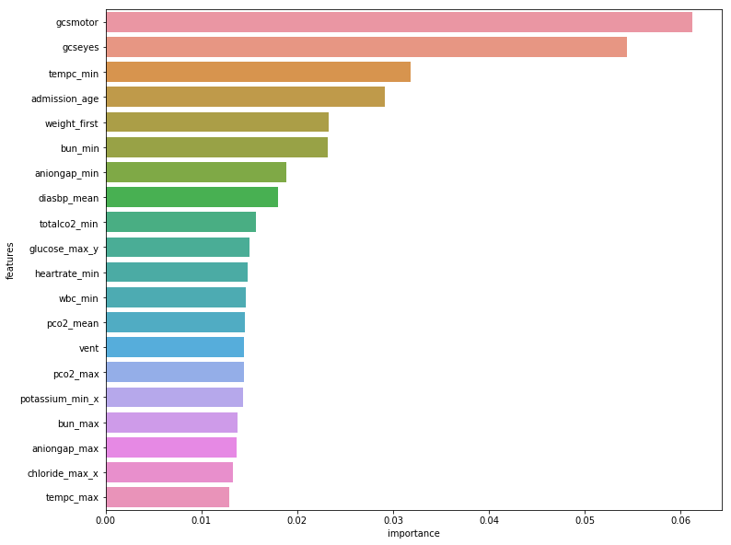
Results cont. 6
RF in-hospital mortality importance

Slide 13
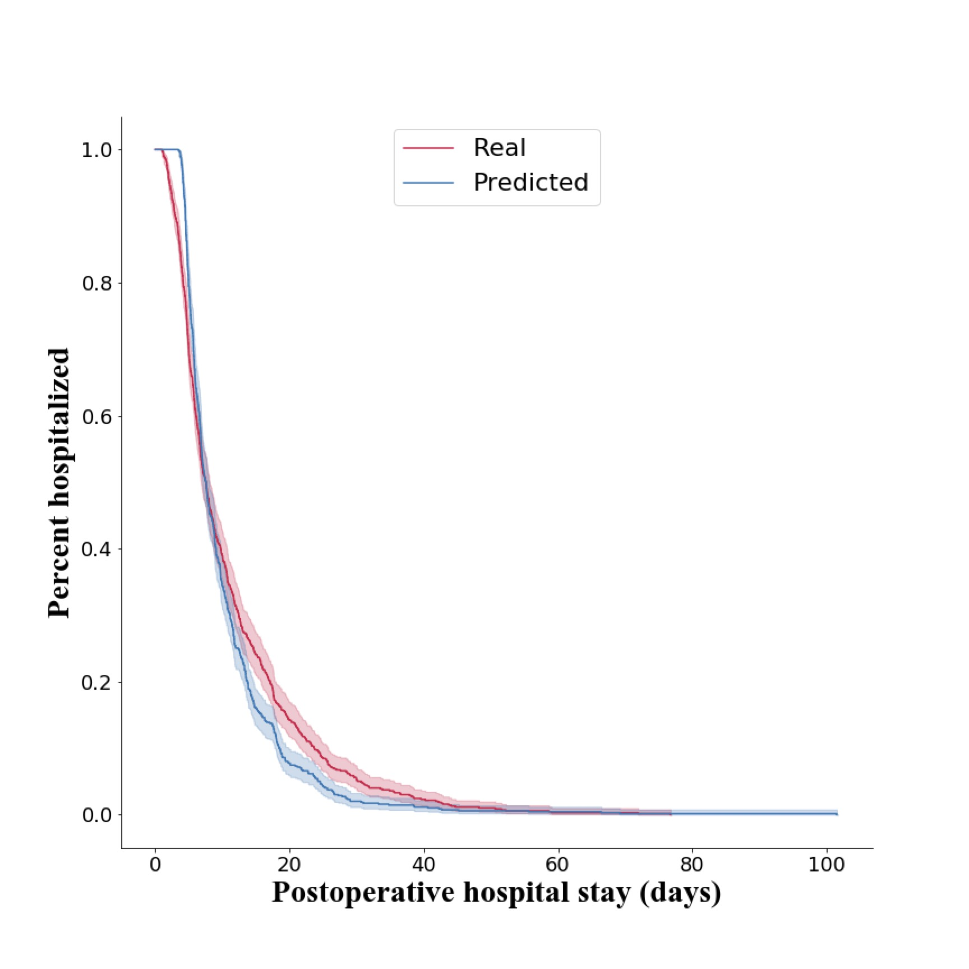
Predicting Length of hospital stay using Cox regression
使用Cox回归预测住院时长
Concordance = 0.901
Mean absolute error = 5.17

Slide 14
Plan for the future
未来展望
Model-wise
Modify the models to increase the recall value
模型还需继续优化、精度有待提高
Establish a real-time warning system
建立实时的预警系统

Slide 15

Thank you for your attention

